Slide 1
ROCKBUSTER STEALTH LLC
Data analysis and insights
Melissa Kock

Slide 2
PROJECT OVERVIEW
GOALS:
Rockbuster Stealth wants to adapt their current business model to include an online streaming service in addition to their physical film rentals
MOTIVATION:
With the technological age, Rockbuster Stealth needs to stay competitive with companies like Netflix and Amazon, therefore adding a streaming platform to their services greatly increases their ability to stay competitive with others in the film rental industry.
Tableau Link:
https://public.tableau.com/views/RockbusterStealthLLC_16471781235430/Top15CountiresSales?:language=en-GB&:display_count=n&:origin=viz_share_link

Slide 3
INVENTORY OVERVIEW
Film Rating | Amount of Films
G | 178
PG | 194
PG-13 | 223
R | 195
NC-117 | 210
Rockbuster has a total inventory of 1000 films across 17 genres including Sports, Animation, Action, Sci-Fi, Family and Drama.

Slide 4
INVENTORY OVERVIEW
 | RENTAL DURATION | RENTAL RATE | FILM LENGTH | REPLACEMENT COST
MINIMUM | 3 | 0,99 | 46 min | 9,99
MAXIMUM | 7 | 4,99 | 185 min | 29,99
AVERAGE | 4,985 | 2,98 | 115 min | 19,98
Highest Value Film
Bucket Brotherhood
Lowest Value Film
Train Bunch

Slide 5
ROCKBUSTER STEALTH LLC
Rental statistics

Slide 6
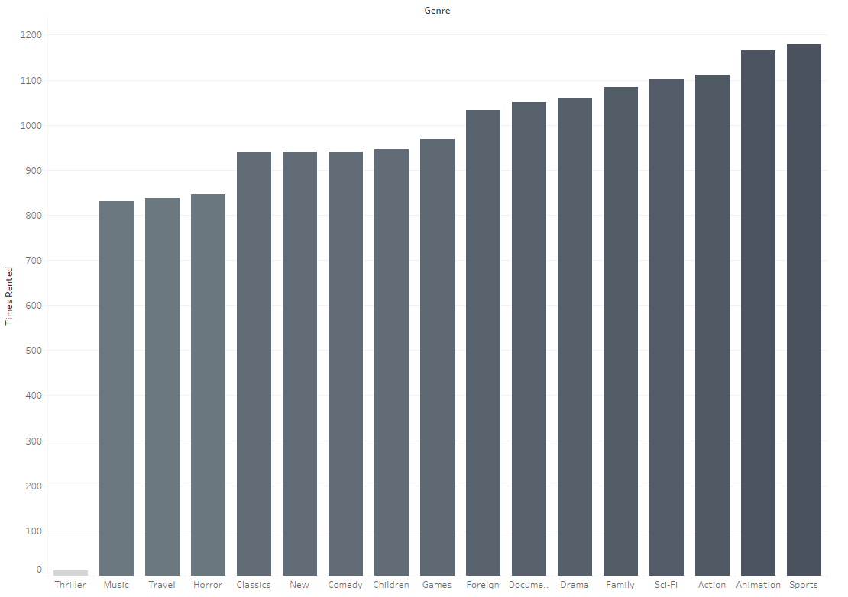
TOP RENTED GENRES
Rockbuster Stealth’s most profitable genres include Sports, Animation and Action, with Thrillers being the least profitable

Slide 7
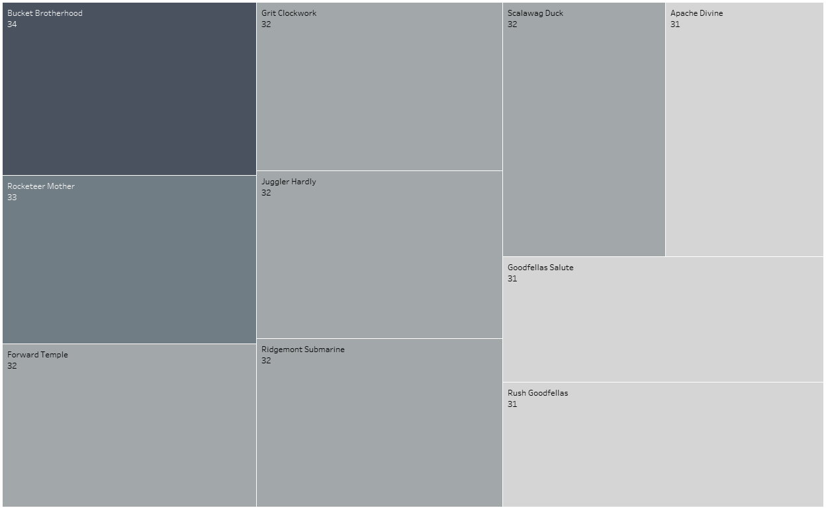
TOP RENTED FILMS
Rockbuster Stealth’s most rented film is Bucket Brotherhood with 34 rentals, followed by Rocketeer Mother with 33 rentals, then a selection of films with 32

Slide 8
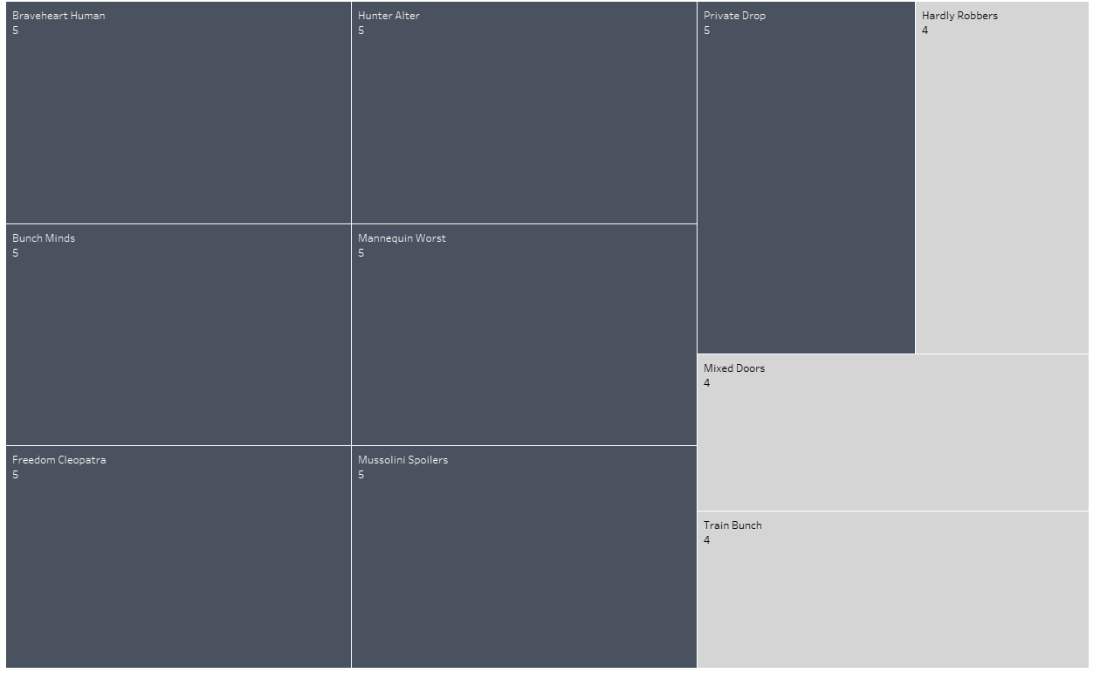
LEAST RENTED FILMS
Rockbuster Stealth’s least rented films are Train Bunch, Mixed Doors and Hardly Robbers, all with 4 rentals, then followed by the selection of films with 5 rentals

Slide 9
ROCKBUSTER STEALTH LLC
Customer Information

Slide 10
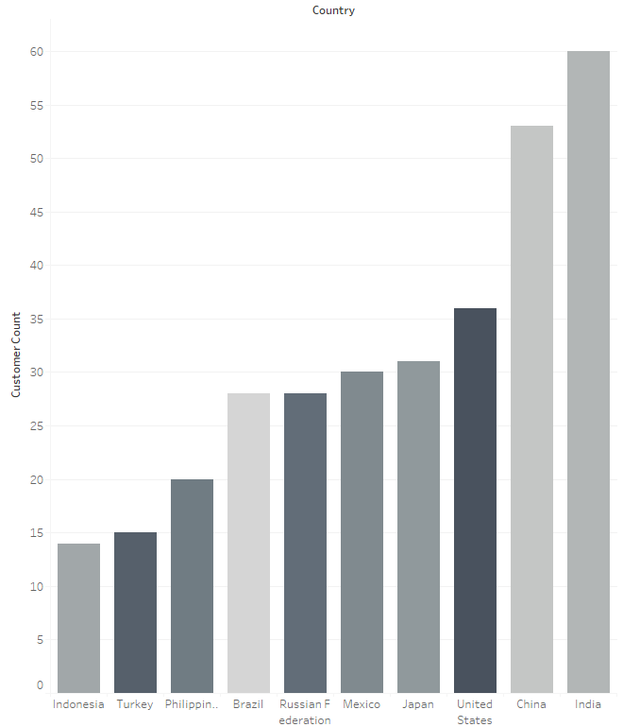
CUSTOMER GEOGRAPHICAL INFORMATION
Rockbuster Stealth’s top 3 largest customer bases are situated in India, China and the United States and continues to Indonesia in the tenth place.
See the geographical representation that follows for a visual overview of the customer localities.

Slide 11
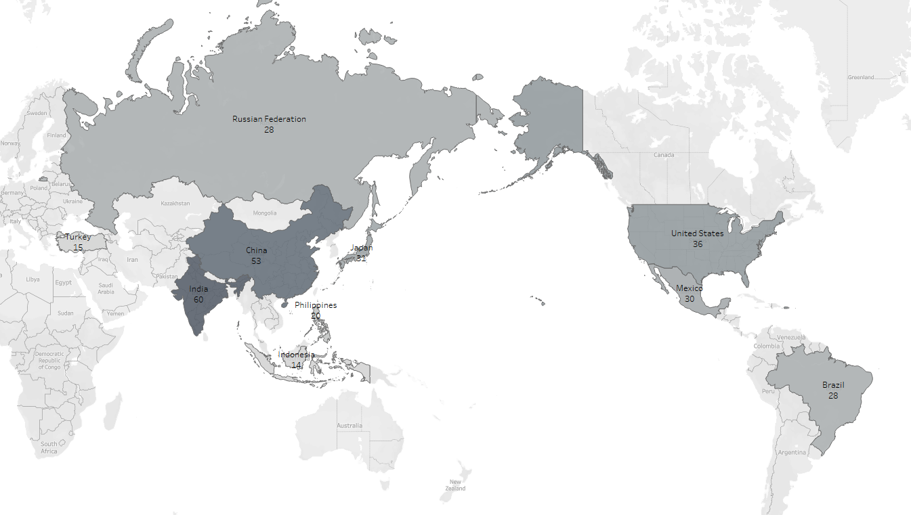

Slide 12
TOP 5 MOST VALUEABLE CUSTOMERS
CUSTOMER | LOCATION | TOTAL AMOUNT SPENT
Casey Mena | Tokat, Turkey | 4443,12
Leslie Seward | Pontianak, Indonesia | 4330,20
Sara Perry | Atlixco, Mexico | 4247,10
Alan Kahn | Emeishan, China | 3113,50
Theresa Watson | Taguig, Philippines | 2661,90

Slide 13
ROCKBUSTER STEALTH LLC
Global Sales Information

Slide 14
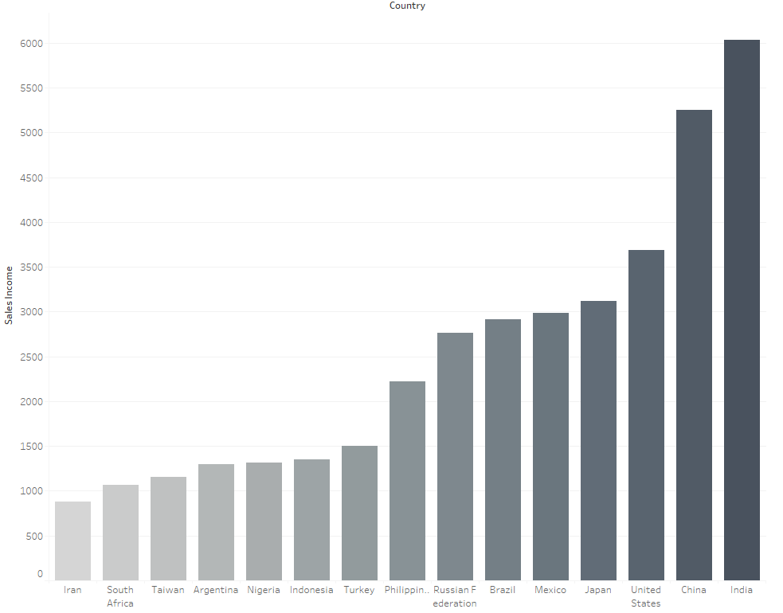
TOP 15 COUNTRIES BY SALES INCOME
Rockbuster Stealth is the most successful in the countries shown in the graph , with India, China and the United States being top 3 once again.
See the geographical representation that follows for a visual overview of the global sales, including all participating countries

Slide 15
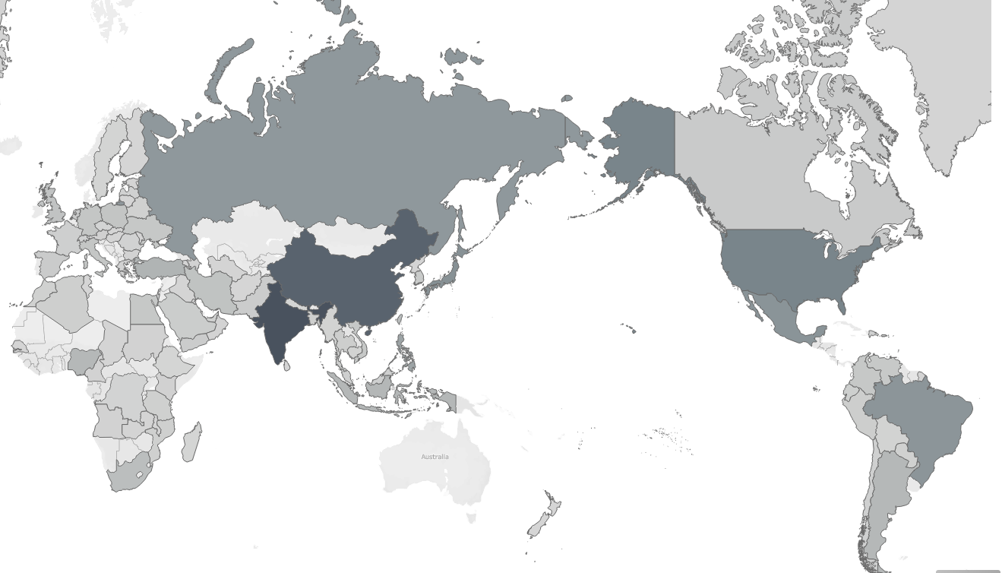


Slide 16
ROCKBUSTER STEALTH LLC
In Conclusion

Slide 17
IN CONCLUSION
India, China and the United States has the largest standing customer base, so starting testing for the streaming service in those countries can give a good indication of how much value the new service will bring Rockbuster. Advertising can also be in focus for these countries.
With Sports, Animation and Action being the highest grossing genres in Rockbuster’s inventory, adding more of these films will greatly benefit the service.
Include newly released films in the online service’s inventory to attract more customers.
Consider expanding countries where Rockbuster is not currently active to have a greater variety in the customer base
Consider adding loyalty programs for customers that give long term support to the company

